Slide 1
Incremental Load with Merge in Qlik Cloud
For near real-time use cases
Alvaro Palacios
Sr. OEM Solutions Architect
March 2024

Slide 2
In-app Merge

Slide 3
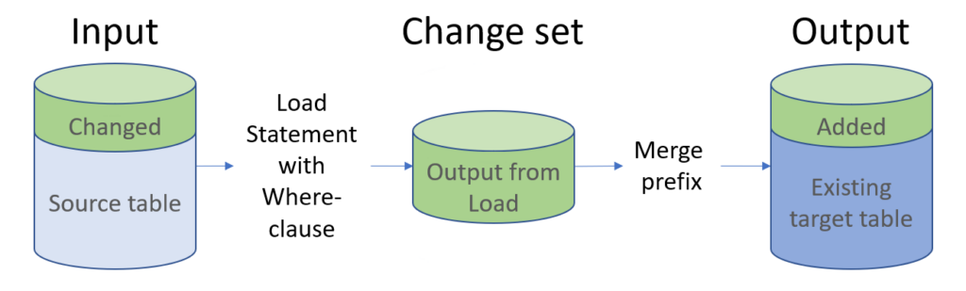

The Merge prefix in the load script
Database e.g. MS SQL Server
Qlik App
Image: https://qhic.se/2023/11/03/incremental-load/ Credits to author Henric Cronström

Slide 4
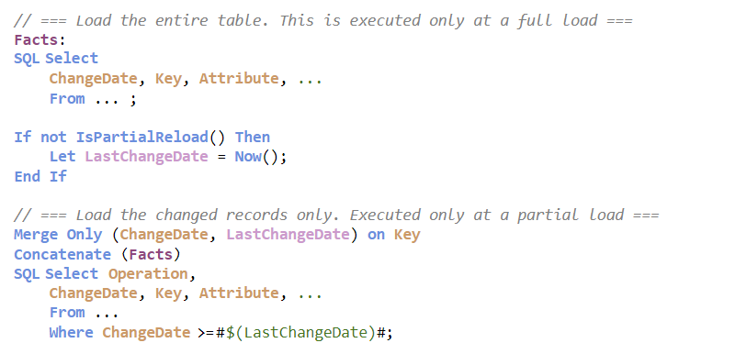


The Merge Only prefix in the load script
Full load
Partial load
Code: https://qhic.se/2023/11/03/incremental-load/ Credits to author Henric Cronström

Slide 5
QVD Merge

Slide 6

The Merge prefix in the load script
Qlik App
QVD file with current view
QVD file includes changes
Image: https://qhic.se/2023/11/03/incremental-load/ Credits to author Henric Cronström

Slide 7
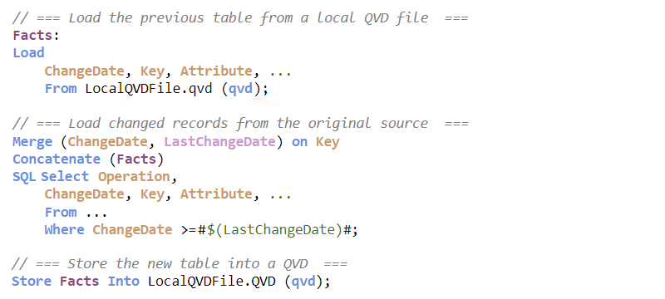
The Merge prefix in the load script
Full load
Code: https://qhic.se/2023/11/03/incremental-load/ Credits to author Henric Cronström

Slide 8
Merge Demo
In-app Merge using SQL Server (AWS) + Partial Reload
QVD file Merge using SQL Server (AWS) + Full Reload

Slide 9
Thanks!

